Slide 1

Unit 5: Lesson 4: Hello, Mr Robot

Slide 2
Open your book, page 88
Task 1: Circle the synonyms of the word obsolete and underline its antonyms.

Slide 3
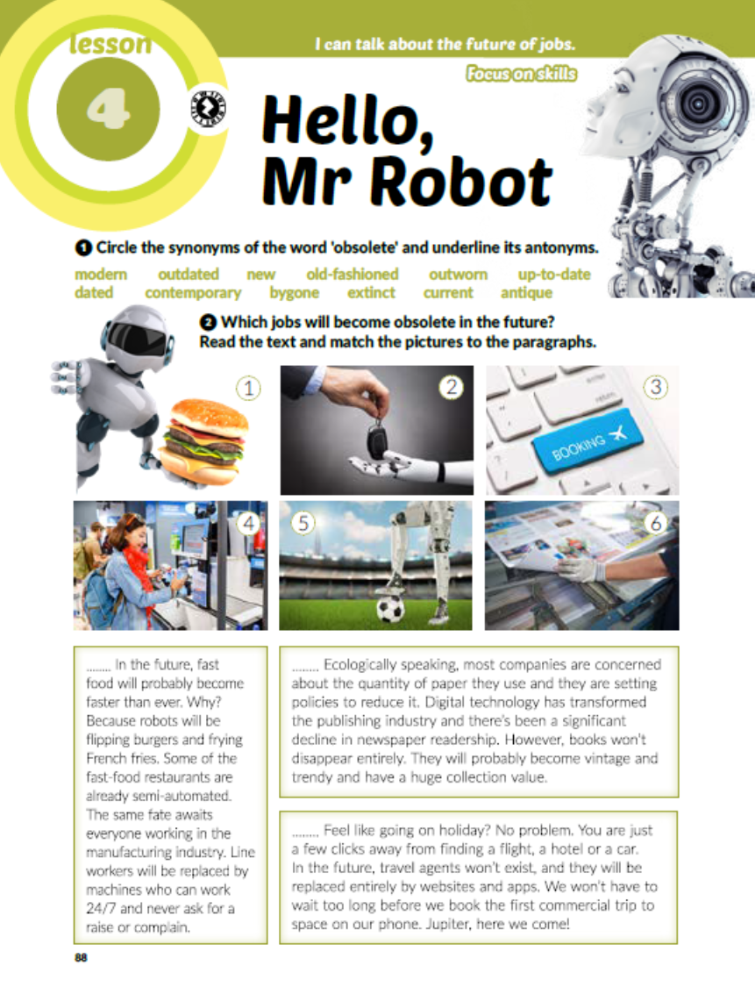
Task 2: Which jobs will become obsolete in the future? Read the text and match the pictures to the paragraphs.
5
4
1
6
2
3

Slide 4
Task 3: Read the text again. Write T for true, F for false or NG if the answer is not given.
F
T
T
F
NG
T
NG
F

Slide 5
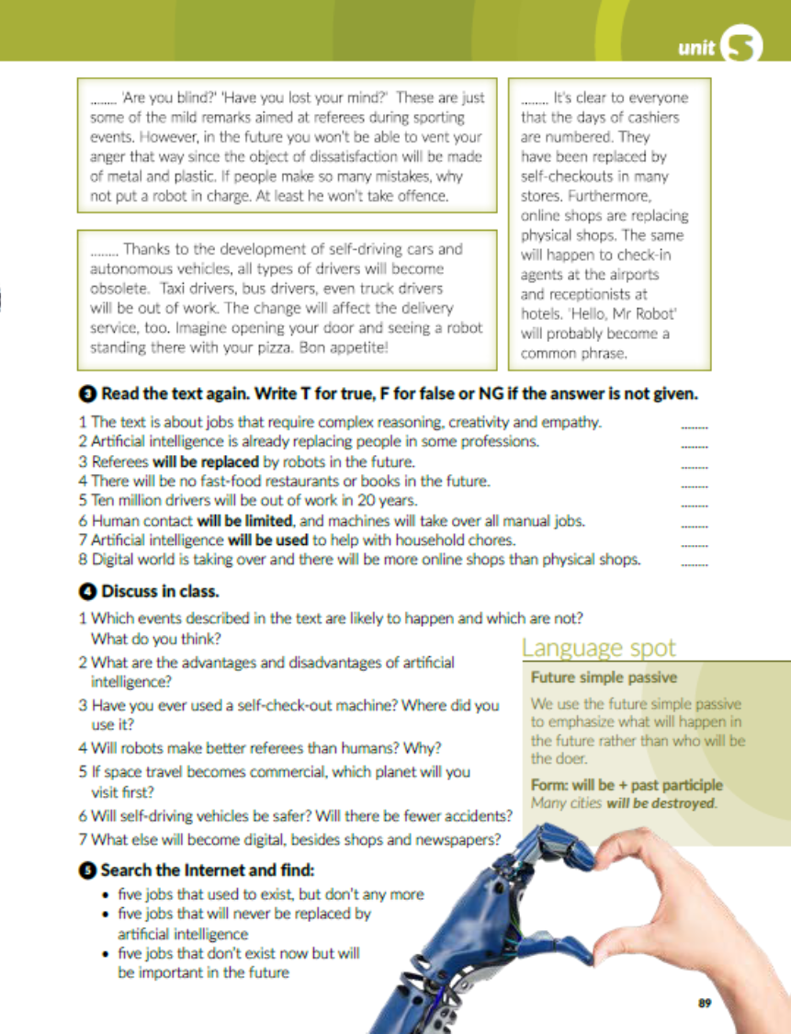
prepiši tekst u rubrici Language spot u bilježnicu.

Slide 7


Slide 8
workbook, page 94
Task 1: Find the odd-one-out.

Slide 9
Task 2: Unscramble the words in brackets and complete the sentences.
raise
collection
commercial
vent
obsolete
delivery
self-checkout

Slide 10
Task 3: If you had a chance to build your own robot, what would it do?

Slide 11
Task 4: What are your predictions for the future?

Slide 12
Task 5: Rewrite the sentences form Task 4 using the passive voice.
A lot of time will be / won’t be spent in the virtual world.
Climate change will be / won’t be reversed.
The wealth gap will be / won’t be closed.
Renewable energy sources will be / won’t be used.
Fossil fuels will be / won’t be burnt.
Less meat will be / won’t be eaten.
Extinct animals will be / won’t be brought back to life.
New planets and life forms will be / won’t be discovered.
New means of communication will be / won’t be discovered.
A contact with aliens will be / won’t be made.
Many jobs will be / won’t be replaced by artificial intelligence.

Slide 13

PLAY AND LEARN!
https://www.e-sfera.hr/dodatni-digitalni-sadrzaji/df41f72b-d019-4bdf-81d7-77f0c7532ac0/

